Slide 1
Tie Back & Long String
Pros and Cons
Yudi & Ashadi, 16 November 2019

Slide 2
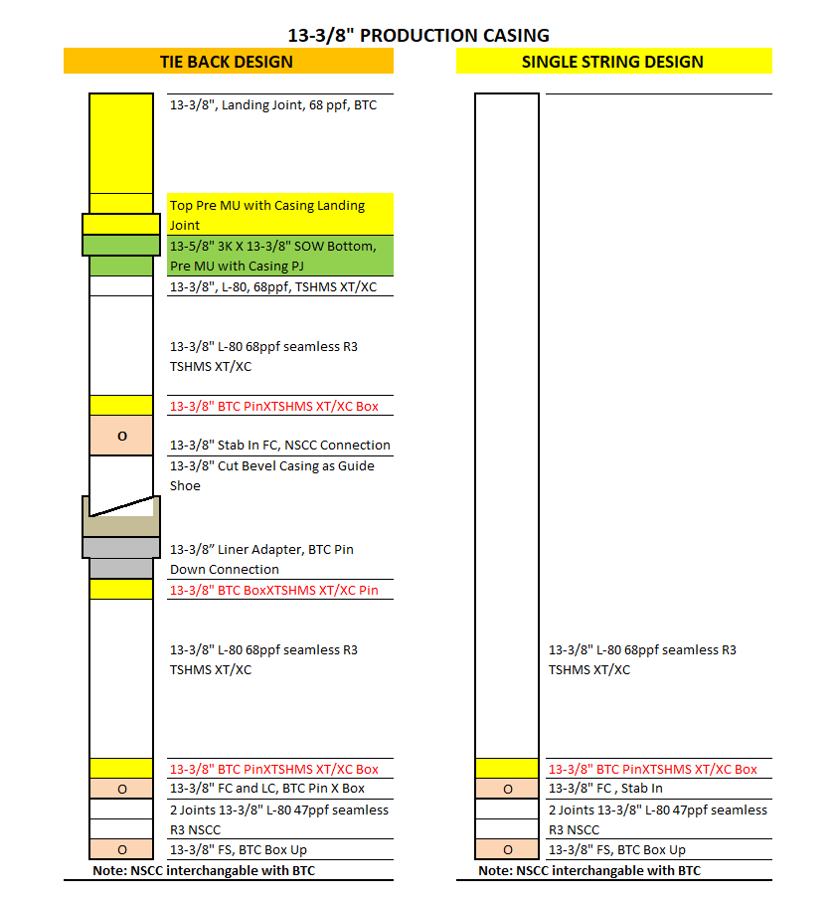
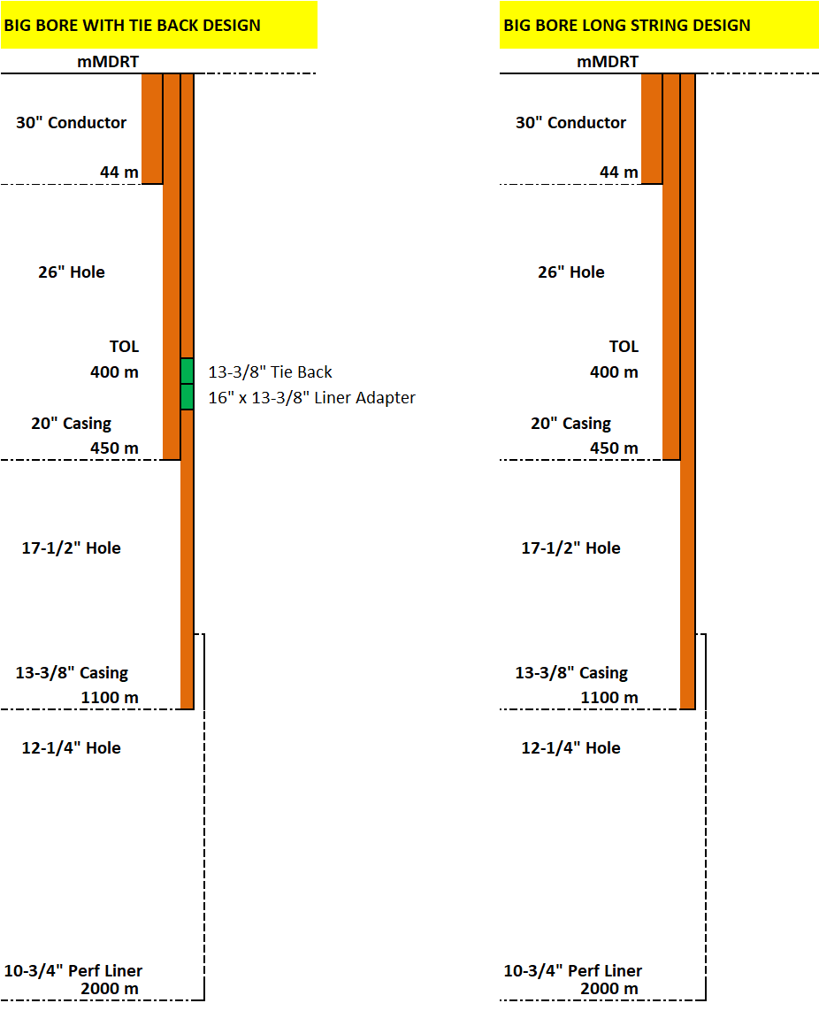
Casing Schematic Comparison

Slide 3
Running Operation
Tie Back Design | Long String Design
Liner Run: MU and run 13-3/8” Liner MU 20” X 13-3/8” Liner Adapter Run with running string (HWDP + DP) Cementing POOH Running String Wait On Cement Run Clean Out BHA Remedial Cement if required Pressure Liner Lap | Single Run: MU and run 13-3/8” Casing Run with running string (HWDP + DP) Cementing Remedial Cement if required POOH Running String Wait On Cement Remedial Cement if required Lift BOP and Cut 13-3/8” Casing and Laid Down ND BOP Cut 20” casing and Final Cut 13-3/8” casing. Risk of heat expose 13-3/8” casing due to cutting torch Weld section A to 13-3/8” casing More rig Time (No pre-welded) NU Master Valve NU BOP
Tie Back Run: ND BOP Cut 20” casing MU and run 13-3/8” Tie Back Casing MU Pre-Welded Wellhead and Land on C Plate Run inner string and stab into FC Cementing. NO Wait On Cement (Casing has been landed on C Plate prior cementing job). NU Master Valve NU BOP

Slide 4
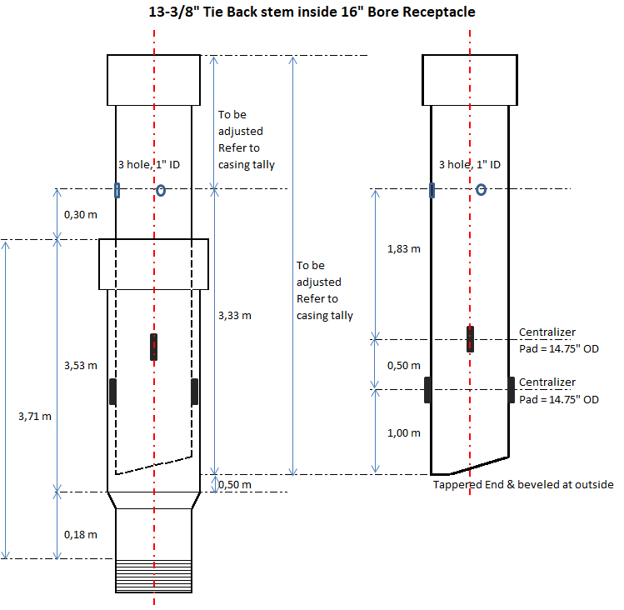
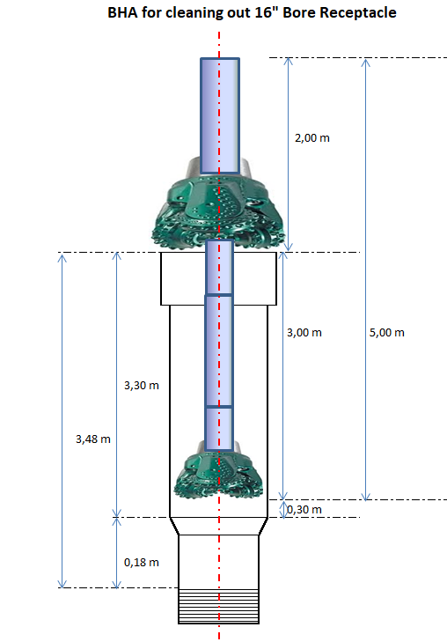
Running Operation – 13-3/8” Liner & Tie Back

Slide 5
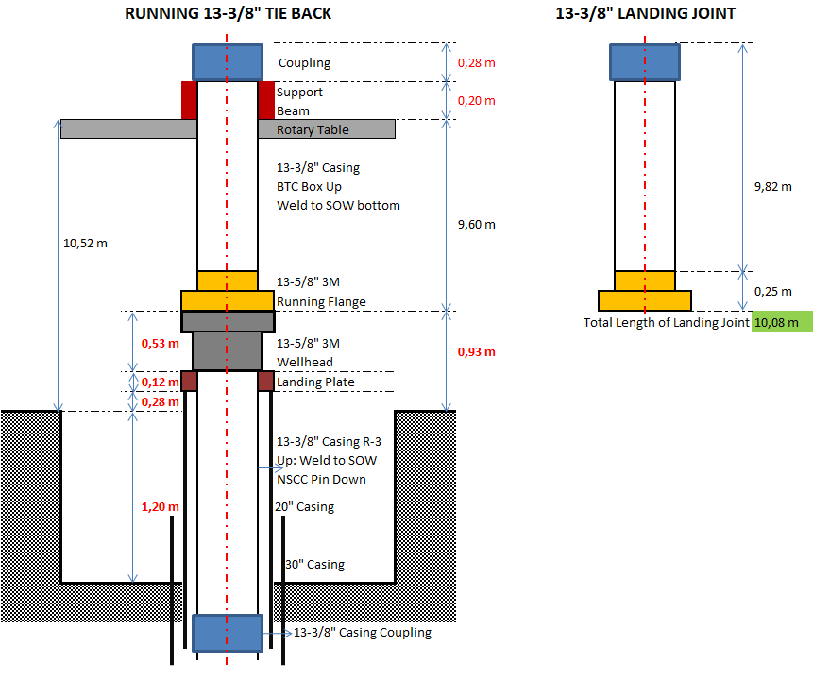
Running Operation – 13-3/8” Tie Back Casing
The 13-3/8” Tie Back Casing will be run with PRE-WELDED Wellhead for rig time saving.
PRE-WELDED Wellhead will be landed on C Plate on 20” casing before cementing → No Wait On Cement is required, we could NU BOP direct after cementing Job.
The 13-3/8” Tie Back Casing will be cemented with heavy cement slurry 16.2 ppg, almost double than water gradient.
  Heavy Cement slurry will easier to remove water in annulus comparing lighter cement used in long string cementing (13.5 ppg).
  Easier to get Free Water in 16.2 ppg Cement slurry comparing lighter cement used in long string cementing (13.5 ppg).
  Much less risk of water trap along 20” X 13-3/8” casing annulus → No well integrity issue.

Slide 6
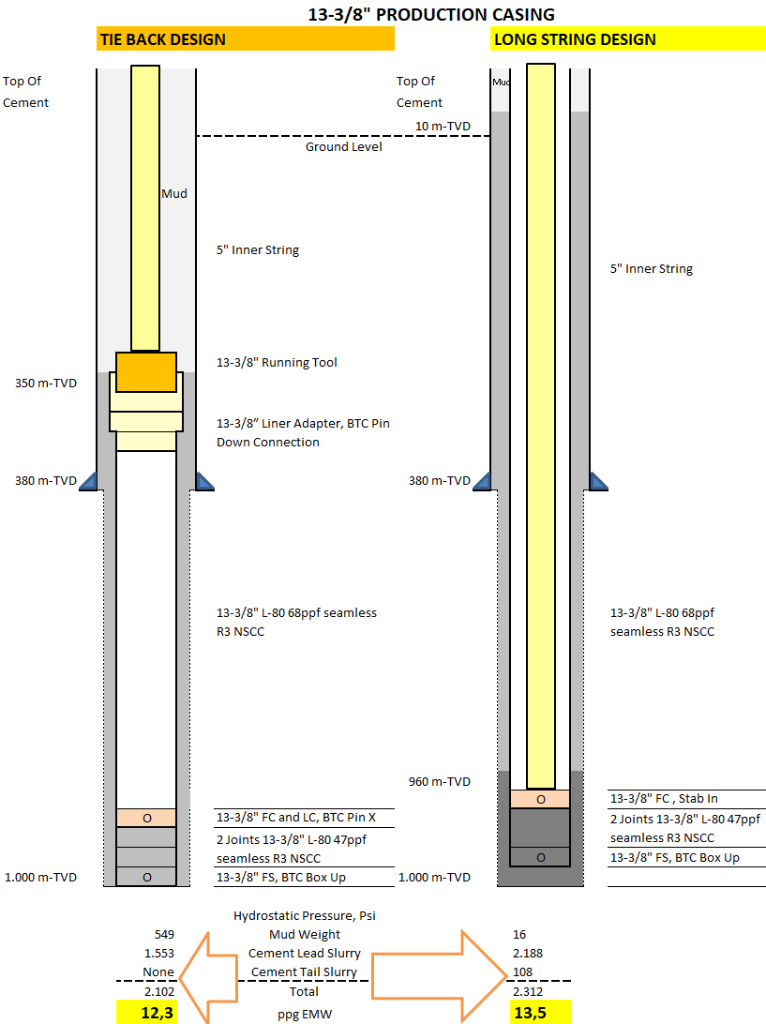
Risk Of Losses While Cementing
Tie Back System: Hydrostatic pressure during 13-3/8” Liner Casing cementing is 210 psi (1,2 ppg) less → Less risk of loss circulation while cementing → lower probability for remedial cementing job.
Tie Back System: Single 14 – 14.5 ppg Cement Slurry: easier to get Free Water Recipe → less risk of water trap in cement when hard → less risk casing collapse when expose to hot temperature when flowing well.

Slide 7
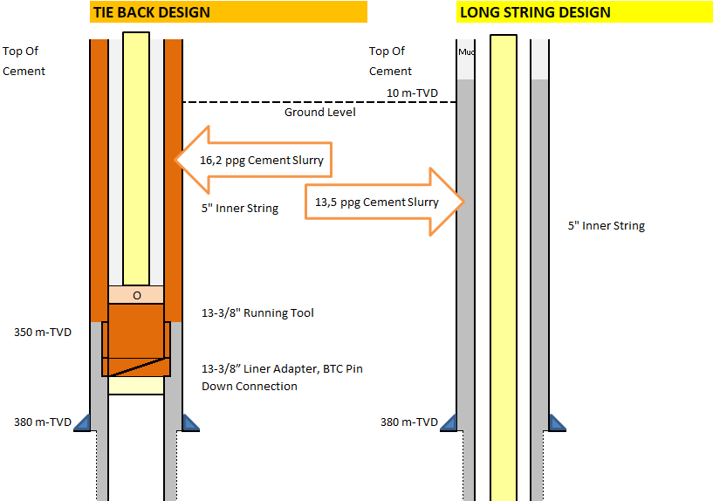
Cement Quality in 20” X 13-3/8” Case Hole
The 13-3/8” Tie Back Casing will be cemented with heavy cement slurry 16.2 ppg, almost double than water gradient.
  Heavy Cement slurry will easier to remove water in annulus comparing lighter cement used in long string cementing (13.5 ppg).
  Easier to get Free Water in 16.2 ppg Cement slurry comparing lighter cement used in long string cementing (13.5 ppg).
  Less risk of water trap along 20” X 13-3/8” casing annulus (short Liner Lap) → No well integrity issue.
The 13-3/8” Tie Back casing will cemented after liner lap being pressure tested to 16,5 ppg EMW → to ensure no losses when pumping 16,2 ppg cement slurry. Until today, no fail on Tie back cementing job.
Good cementing quality with 16.2 ppg slurry → better anchoring for 13-3/8” production casing → less casing and wellhead expansion growth.

Slide 8
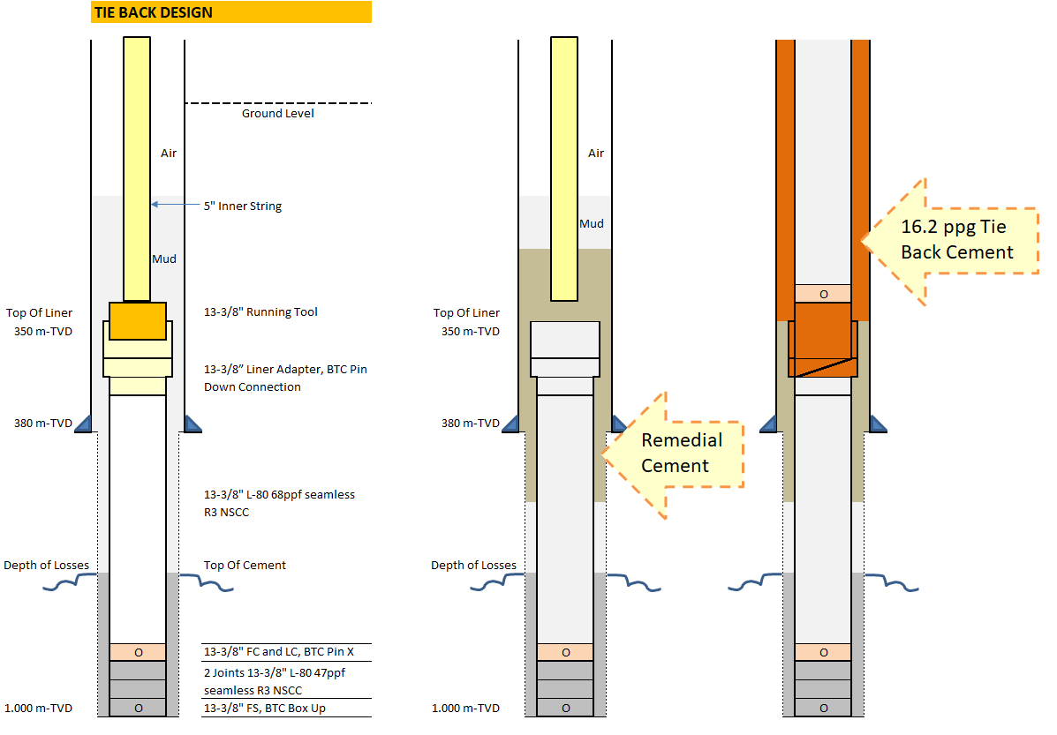
Remedial Cementing – Tie Back Design
If any losses during cementing, we will do remedial cementing by dropping or squeezing 15.8 pp cement → until we could pressure test liner lap to 16.5 ppg EMW.
It is easier since shorter length for remedial cement → 30-40 m liner lap and open hole annulus.
In no injectivity rate:
  Pressure test liner lap to 16.5 ppg EMW, if leaked, squeeze cement.
  Run and cement 13-3/8” Tie Back.
Good Casing and Cementing Integrity.
If any Total Losses during remedial cement and fail cured with cement plug:
Pump Fast set cement Recipe (Econolite + Spacer + 15.8 ppg Cement

Slide 9
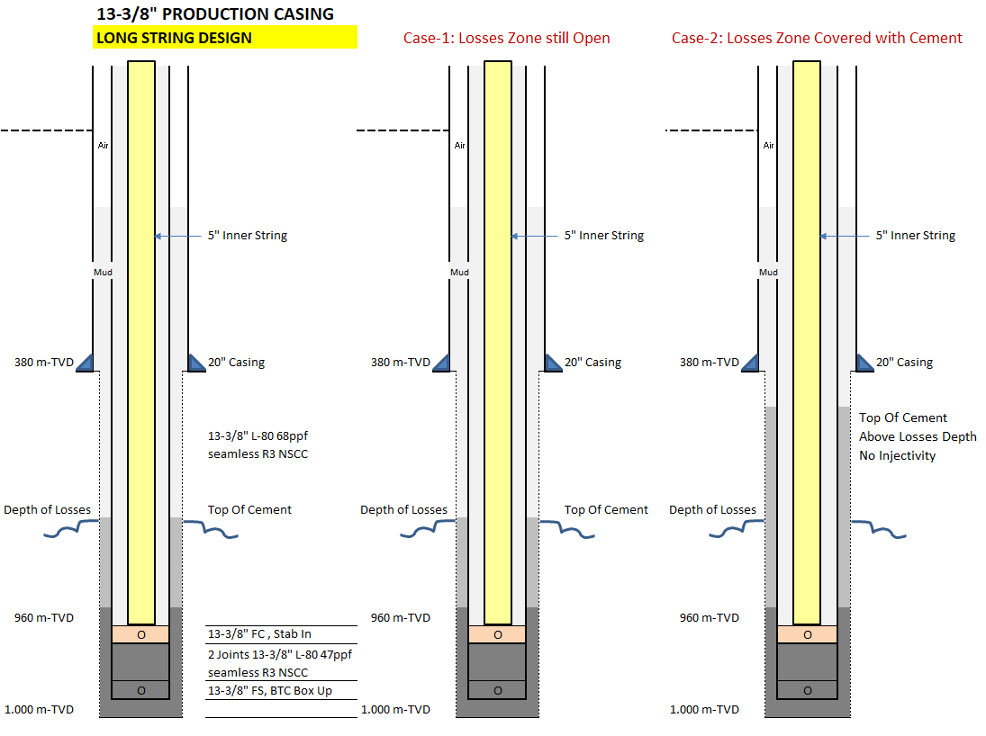
Remedial Cementing – Long String Design
Case-1: Losses Zone still open
Cement Top Job by pumping cement slurry thru annulus.
The heavy cement slurry will drop into long annulus section, can not control cement speed → risk of mixed with water inside annulus → Risk of free water > nil → water trap and cause well integrity issue.
If still losses: Pump Thixotropic cement ahead and follow with remedial cement slurry → risk of premature set if any stop pumping → lack of cement quality along case hole section.
All above points could initiate well integrity issue.

Slide 10
Remedial Cementing – Long String Design
Case-2: Top Of Cement Above Losses Depth causing No Injectivity:
Unable to pump remedial cement slurry.
Long Un-cemented 13-3/8” Production Casing
When flowing during well test or production phase, cause higher casing expansion and cause wellhead growth → damage on surface pipe line connection.
Again the above points could initiate well integrity issue.
Case-1 and 2 are more difficult Remedial cement job, may need longer rig time.

Slide 11
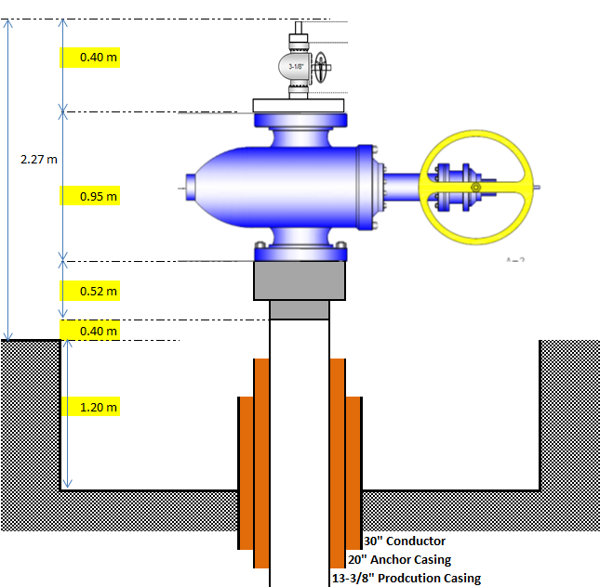
Wellhead & MV Installation
13-5/8” 3M Section A Wellhead
12” ANSI 900, Master Valve
Companion Flange
3
13-5/8” 3M Section A Wellhead Installation:
13-3/8” Tie Back Design:
  Pre-welded in horizontal position
  32-40 hours
  Off line job → no use Rig time
13-3/8” Long String Design
  To be welded in Vertical position, after cementing job and final cut 13-3/8” casing
  Rig Time: 32-40 hours
  Can not do Off Line → Use Rig time
  Option to expedite welding job → by pressure testing in hot condition → risk of lack on welding quality
2
1
Welded Connection

Slide 12
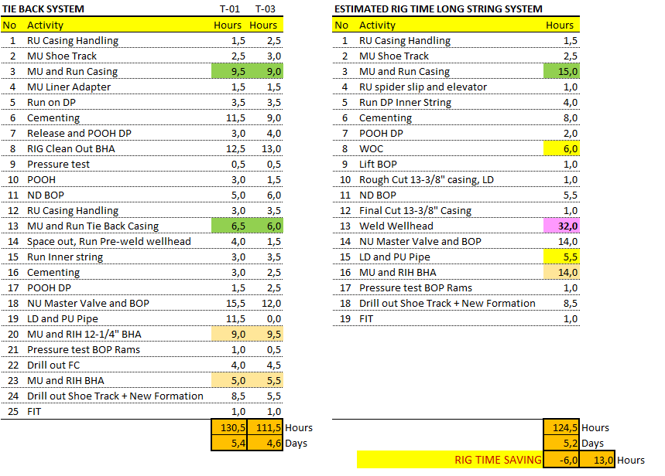
Rig Time Comparison
Rig Time Comparison – No NPT and No Remedial Cement:
Comparing SMP T-01: Long String could create 6 hours rig time Saving.
Comparing SMP T-02: Long String could be 13 hours Longer rig time.
Risk of longer rig time IF run Long string method:
Problem when weld 13-5/8” SOW Wellhead to 13-3/8” L-80 Casing.
Difficulties for Remedial Cementing Job.

Slide 13
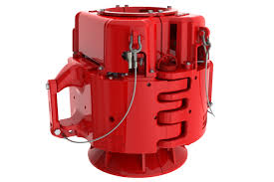
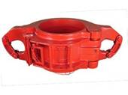
Additional Cost
13-3/8” Tie Back System | 13-3/8” Long String System
Run 13-3/8” Casing into two section → Less weight of running casing. It is sufficient to use 150 T Single Casing Elevator. This Equipment is part in the contract, no additional cost. | Run 13-3/8” casing in single run. It is still within 150 T Single Casing Elevator without any Safety factor. It is recommend to run 13-3/8” Long String with 350 T Spider Elevator. This equipment was not in the casing handling contract. Additional cost: Equipment Rental = USD 18000 per well Mob/Demobilization = USD 6000 per call
Need 20” X 13-3/8” Liner Adapter, additional Cost: 20” X 13-3/8” Liner Adapter: USD 15000 / Set Running Tool: USD 5000 / Well 17-1/2” Hole Opener: USD 21000 for 3 well 14-3/4” Mill Tooth Bit: USD 12000 for 3 well | No 20” X 13-3/8” Liner Adapter
Total Additional Cost: USD 31000 | Total Additional Cost: USD 18000 + 6000/3 = USD 20000
Cost Different between Tie Back vs Long String:
USD 11000
NOT Significant

Slide 14
Conclusion
Strongly NOT Recommend to run Long String Design for Geothermal Well:
Cementing 13-3/8” Casing is the most critical job to be main isolation and anchoring system. Remedial cement in Long string is more complicated and difficult comparing Tie back design.
No Rig Time saving expected from Long String Method, since we must weld 13-5/8” SOW wellhead on line (Rig Time) and higher risk of longer rig time due to difficulties to do Remedial Cementing on 13-3/8” Long Production Casing string.
In 13-3/8” Tie Back System where the casing is divided into 2 section, It could make better items of casing stress distribution due to casing expansion during well flowing.
It was experienced that Long string Design contributed to the Lack of well integrity.
Most Geothermal Operators in Indonesia have abandoned to use Long string method due to well integrity concerns.

